Slide 1
Scrabble Game
Developed By:
Syed Muhmmad Faheem 20K-1054
Mohsin Ali Mirza 20K-353
Ahmad Aleem 20K-0169

Slide 2
Introduction
Scrabble is the ultimate crossword game in which every letter counts.

Slide 3
Implementation
Scrabble Rounds with both players
Meaning and all grammatical info of the word entered.
Suggestions of word if the user requires

Slide 4
Data Set
Word | Meaning
AA | Hawaiian) a volcanic rock consisting of angular blocks of lava with a very rough surface [n -S]
AAH | an interjection expressing surprise [interj] / to exclaim in surprise [v -ED, -ING, -S]
AAHED | AAH, to exclaim in surprise [v]
AAHING | AAH, to exclaim in surprise [v]
AAL | AAH, to exclaim in surprise [v]
AALII | (Hindi) the Indian mulberry tree, aka noni, also AL [n -S]
. . . | . . .
ZYMOLOGICAL | relating to zymology, the science of fermentation, also ZYMOLOGIC [adj]
ZYMOLOGIES | relating to zymology, the science of fermentation, also ZYMOLOGIC [adj]
ZYMOLOGIST | one who is skilled in zymology, or in the fermentation of liquors [n -S]
ZYMOLOGISTS | ZYMOLOGIST, one who is skilled in zymology, or in the fermentation of liquors [n]
ZYMOLOGY | the science of fermentation [n ZYMOLOGIES]
ZYMOLYSES | ZYMOLYSIS, the action of enzymes [n]
ZYMOLYSIS | the action of enzymes [n ZYMOLYSES]

Slide 5
Functions
Class Trie
void insert(Trie *root,string s,string meaning)
text
bool search(Trie *root,string s)
text
void prefixSuggestions(Trie *root,string s)
text
void prefixSearch(Trie *root,string s)
text
void anschoice()
text
void loadingpos(int x,int y)
Text
int loading()
text
int Process()
text
void displayRules()
text
void displayRepeat()
text
void display()
text
int main()

Slide 6
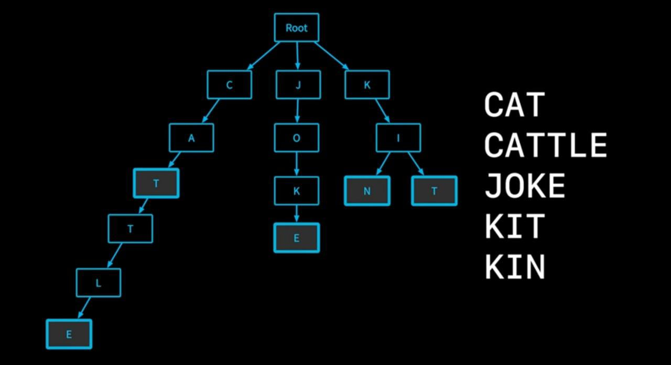
Definition
Trie
Trees
The word "Trie" is an excerpt from the word "retrieval". Trie is a sorted tree-based data-structure that stores the set of strings.
The maximum number of nodes is the size of alphabetic letters.
The time complexity is O(L), where L is the length of the word.
All the children of a node have a common prefix of the string associated with that parent node, and the root is associated with the empty string. This task of storing data accessible by its prefix can be accomplished in a memory-optimized way by employing a radix tree.

Slide 7
Properties
Trie
Trees
The root node of the trie always represents the null node.
Each child of nodes is sorted alphabetically.
Each node can have a maximum of 26 children (A to Z).
Each node (except the root) can store one letter of the alphabet.

Slide 8
Advantages
Trie
Trees
Insertion and searching of strings can be done in O(L) time where L represent the length of a single word.
Printing of all words can be done in alphabetical order by doing preorder traversal which is not easily possible with hashing.
Prefix search can be done (or auto-complete) with Trie.

Slide 9
Drawbacks
Trie
Trees
The main disadvantage of tries is that they need a lot of memory for storing the strings.
If the memory footprint of a single node is K references, and the trie has N nodes, then obviously its space complexity is O(N*K).

Slide 10
Comparison
Trie
Trees
Trie Trees
The root node of the trie always represents the null node.
Hashing
Also require large amount of memory to store.
Self Balancing BSTs
The Basic CURD Operations take O(L*logn) time on average.
Each child of nodes is sorted alphabetically.
Each node can have a maximum of 26 children (A to Z).
Each node (except the root) can store one letter of the alphabet.
Need to implement hashing function.
Same time complexity.
Cannot print in alphabetical order.
Collisions exist

Slide 11
Conclusion
Trie
Trees
They are faster but require huge space to store strings.
If access of large memory is a problem:
Ternary Search Trees can be used to cater this problem, but the time complexity of that data structure is O(h) where h represents the height of the tree.

